Slide 1
Flatirons Volleyball Club Sports Nutrition Presentation
Bryan Snyder, RD
Registered Dietitian
Denver Broncos-Director of Team Nutrition
Denver Nuggets-Consulting Sports Dietitian
Colorado Avalanche-Consulting Sports Dietitian
Colorado Rockies-Consulting Sports Dietitian

Slide 2
Background
Born and raised in Simla, CO
Population---400
Graduating Class---18
Parents are teachers and coaches so I spent a lot of time on a field or in a gym which developed my passion for sports
3 sport athlete in high school
Played basketball at University of Colorado at Colorado Springs and attended 2 years of college at UCCS.

Slide 3
Background (cont.)
Finished Bachelors at UNC (2009)
Josh McDaniels hired as Broncos Head Coach and wanted an RD
Interviewed my senior year in college and was brought in for internship for the season (2009)
Hired FT in 2010 and worked while completing my dietetic internship
Live in Aurora, CO with my wife Sarah, 8 year old son Kooper, 6 year old daughter Londynn, 4 year old daughter Annistynn, 2 year old daughter Emmy, and 6 month old son Beauen.

Slide 4
Duties and Responsibilities
1-1 Consultations with every single athlete
  Every training camp and periodically throughout the season
  Any new player we sign
  Complete nutrition profile and game plan
  Helping players gain or lose weight and hit target body composition
Dietary Supplement Evaluations
  Spend a lot of time evaluating supplement labels
  90% take some kind of dietary supplement
Travel
  Write menu for planes and hotels and coordinate with hotel staff
Game-day and Sideline
  Hydration and cramp prevention
  Fueling pre-game and half-time
Staff consultations
  General
  Coaches and staff

Slide 5
Duties and Responsibilities
Sleep research
  Work with athletes and educate them on the importance of sleep and taking care of their body!
Sweat testing and hydration studies
  Custom bottles on the sideline!

Slide 6
Sports Nutrition Basics
Fuel with Carbohydrates!
Carbohydrates
  #1 fuel source the body uses for energy. Primary fuel source
  Decrease in carbohydrate intake = decrease in muscle glycogen stores = hitting the wall!
  It takes less oxygen to burn carbohydrates than anything else
  Protein sparing
Protein
  Used as energy when muscle glycogen stores are gone!
  If your diet is inadequate in carbohydrates, especially before a game, your body will convert amino acids (from muscle) to glucose for energy.
  Why is this bad? It will lead to a loss in lean muscle mass!
Fat
  Used as energy source in low intensity exercises.
  Not an efficient way to increase energy!

Slide 7
Common Questions and Challenges for Adolescent Athletes
I speak to youth and adolescents in a group setting at least 20 times every single year and 95% of the questions that I get from coaches, parents, athletes pertain to one of these topics below.
Pre-game fuel
Hydration
Sleep
Recovery
Supplements
Anything not covered here just ask!!!!

Slide 8
Pregame Nutrition
The Night Before
Starts the night before!
  What you put in your body the night before will directly impact your energy levels throughout the game.
  Focus on a balanced meal with an emphasis on carbohydrates.
  Examples:
    Lean proteins, complex carbohydrates, and fluids!
    Pasta with meat sauce, lean protein (turkey, chicken, pork tenderloin, tilapia, cod, salmon)
    Whole grains (bagels, buns, bread, breakfast cereals)
    Baked potatoes and baked sweet potatoes
    Fruits and starchy vegetables

Slide 9
Pregame Nutrition
3-4 Hours Before Game
Small to medium size meal
High Carbohydrate, moderate protein, low fat
  Fruit bread, bagels, muffins
  Turkey sandwich
  Low fat yogurt
  Sports drink
  Breakfast cereal with low-fat milk
  Fresh fruit
  Cereal Bars (Nutrigrain bars, granola bars, Clifbar etc…)
  Nuts including trail mix
    In moderation

Slide 10
Pregame Nutrition
2-3 Hours Before Game
Liquids and some light solids
  Liquids digest at a quicker rate than solids
Light solid options (preferred 2 hours later)
  Toast, bagels, muffins, yogurt, fruit, sports drink, cereal with low fat milk, granola bar, ½ turkey and cheese sandwich, banana bread, low fat muffins
Stay away from high protein, high fat items that take a long time to absorb and digest

Slide 11
Pregame Nutrition
1 Hour or Less
    Bananas and Oranges
    Applesauce
    Ritz Crackers
    Crackers and cheese
    Yogurt
    Fruit snacks
    Gatorade
    Granola Bars

Slide 12
Pre-game meal and Pre-practice meal
The night before we should be focusing on 65-70% of your meal coming from carbohydrates, followed by lean proteins, vegetables/antioxidants, and fluids.
Sometimes the simplest meals get overlooked because we feel that there ”has to be something better.”
Broncos/Avalanche eat this meal every single night before a game
How many of you have seen this menu as an option or heard a coach tell you to have this the night before a game?

Slide 13
GAME DAY SNACKS AND SCHEDULE
3-4 Hours Before Practice/Game
70% Carb and 30% Protein
Examples:
Turkey and cheese sandwich with piece of fruit and water
Bagel with peanut butter and glass of orange juice
Egg, potato, cheese breakfast burrito
English muffin with light jam, bowl of fruit, water
1-2 Hours Before Practice/Game
80% Carb and 20% Protein
Examples:
Cheese and Crackers
Banana with Peanut Butter
Greek yogurt with Granola
Cliffbar
Trail mix (handful)
Cereal with 1% milk
Small piece beef jerky with banana
1 Hour or Less Before Practice/Game
Focus on majority of Carbs with light amounts of lean protein
Examples:
Gatorade
Pretzles
Goldfish Crackers
Rice Crispy Treats
Nutrigrain Bars
Granola Bars
Fruit Snacks
Plain Yogurt

Slide 14
RECOVERY NUTRITION
YOU HAVE 30 MINUTES!
  Studies show you have a 30 minute window after practice and games to get carbohydrates and protein in your bodies.
  Typically takes your body 24-36 hours to totally recover from strenuous activity like a practice or game.
  By consuming primarily carbohydrates and small amounts of protein within 30 minutes of a game or practice, the recovery process begins sooner and you could potentially be recovered between 12-16 hours!
  Looking for a 4:1 ratio of carbs: protein
  Examples would be chocolate milk, yogurt, recovery bars, whole fruit, peanut butter and jelly (Jamz), crackers, string cheese, banana with peanut butter.

Slide 15
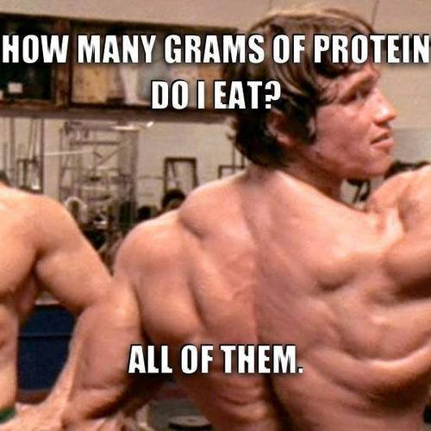
Recovery Nutrition
Carbohydrates + Protein + Fluids
Stress carbohydrates coupled with protein
  Case: Player throwing ingredients in a blender.
    8 oz. water
    Ice
    4 cracked eggs
    3 scoops 100% Whey protein
    90-100 grams protein with zero carbs
Protein Sparing
  We can’t have players losing lean muscle mass throughout the course of the season. We can prevent this through proper education, diet, and recovery.
Only takes about 20 grams to begin muscle synthesis
Protein without carbohydrates does not work for recovery.
http://gymmemes.tumblr.com/
Dietitians of Canada and American College of Sports Medicine Joint Position Statement---Nutrition and Athletic Performance

Slide 16
UP TO YOU!
As athletes it is not up to your parents or your coaches to remind you to take care of your bodies.
It is up to you!
Plan ahead, SLEEP, pack a bag, put snacks in your locker…
Common phrase from athletes when I ask them what they eat before games and practices
  Well “they” don’t give us anything so we have to eat concession stand food.

Slide 17
The Importance of Breakfast
Common things I hear student athlete’s say.
  “I don’t have time to eat breakfast”
  “I don’t like my breakfast options.”
If you are short on time: Try the following options:
  Yogurt with string cheese
  A couple pieces of whole fruit
  Nutrigrain bars/granola bars etc…
Something is better than nothing!
No excuses…Eat breakfast!
Not eating breakfast is like getting ready to go on a road trip and not putting gas in the gas tank.

Slide 18
Focus and Concentration
Being depleted and not having enough carbohydrates is the #1 reason that high school athletes lose focus and concentration.
Carbs fuel your brain! No carbs = No focus!

Slide 19
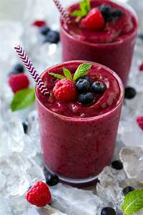
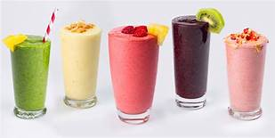
Increasing Fruits and Vegetables
Increasing fruits and vegetables are easy!
The more colors you get the more antioxidants you get which prevents you from getting sick! Aim for a variety of colors!
Make a smoothie!
  Strawberries, banana, blueberries, tart cherries, Greek yogurt etc. gets you nearly 5 servings and is a great way to start the day!

Slide 20
Gluten Intolerance
Gluten is a substance/protein that is responsible for the elastic texture of dough. Some people have an allergy.
Highly debated
1% of the population has Celiac Disease, 5% have an allergy or intolerance, and 25% of people follow a GF diet. This means that 19-25% of people are following a diet and they don’t need to.
Unless you have Celiac Disease----You do not need to avoid gluten. There is not enough evidence or science to say that gluten is bad for you…in fact, gluten free foods are some of the most unhealthy foods that you can actually eat from a preservative and ingredient standpoint.
If you feel that you have an intolerance, speak to your doctor and they will either run a blood test or they will run a Biopsy of the small intestine.

Slide 21
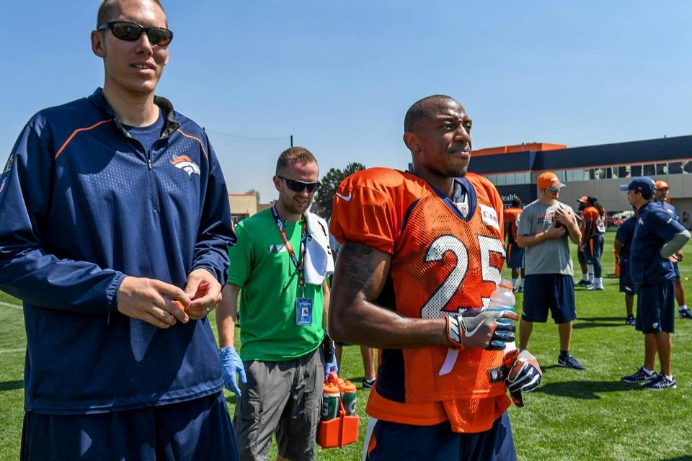
Hydration for Performance
  Goal is to maintain fluid balance
  Sweat rates will increase with workload
  Must replace water to prevent fatigue
  Reduction in body mass of 1-2% results in 44% reduction in performance

Slide 22
Hydration and Athletic Performance
Hydration Performance Facts
    Whether or not you are hydrated DOES impact your performance.
    Dehydration IS preventable
    If you aren’t doing your part to stay hydrated, simply put, you are letting your team down
    Your diet can be perfect but if you aren’t hydrating properly you can still be tired, fatigued, and not perform at the highest level.
    You may have not felt the impact yet that altitude has on your body.
      Altitude DOES impact hydration status

Slide 23
Hydration and Athletic Performance
Consequences of Dehydration
  Causes a decrease in athletic performance
    A drop in 2% of your body weight (3-5 lbs) can have a significant negative effect on athletic performance.
    I have seen NHL players lose between 2-12 lbs per practice
  Causes muscle fatigue, damage, and cramps
    Many muscle strains and tears can be traced back to a dehydrated muscle
  Keeps heart rate and body temperature high
    We don’t want that. This means more calories burned, fluid used, and muscle glycogen (energy) being used.
    Lower weight in bod pod due to dehydration of traveling

Slide 24
Hydration for Performance
How do I know I am dehydrated?
  Urine color
    You want your urine to look like water or lemonade
    Great indicator of dehydration
  Weigh before and after practices
  Most athletes aren’t losing muscle or fat during one practice or game…If you are losing weight it reflects hydration!
  Sweat stains
    Heavy sweaters often have sweat rings around their head, neck, and chest.
    This shows you are at an elevated risk for dehydration.
    Place an emphasis on sodium. Consume a mix of water and sports beverage like Gatorade

Slide 25
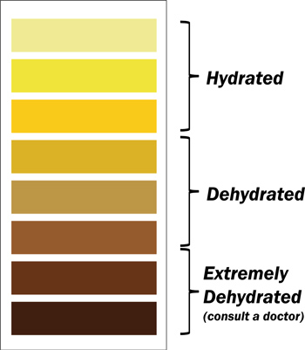
Am I Dehydrated?
Best way to determine hydration status?
  Urine color!
  Aiming for clear or lemonade color
Before and after weigh in
  Weigh yourself before and after practice and games.
  You need to drink 16-24 oz of fluid for every pound lost.
  This is a minimum of 1 bottle (16oz) of water for every pound lost.
Salty Sweater?
  Sweat rings---Increase sodium

Slide 26
Hydration for Performance
How do I stay hydrated?
  Many athletes go in to practices and games ALREADY dehydrated
  Drink 16 oz of water or sports drink around 2-3 hours before competition.
  Drink 16-24 oz of water or sports drink for every pound lost during practice or competitions. Consume this before your next practice!
  STAY AWAY FROM ENERGY DRINKS

Slide 27
Sports Drinks or Water?
  General Recommendation:
  If exercising longer than one hour it is recommended you consume a sports drink like Gatorade. Why?
    Electrolytes---Sodium, potassium etc…
    Sodium makes you thirsty which leads you to drink more!
    Carbohydrates---Energy source for muscles

Slide 28
Sports Drinks or Water?
  Alternative to Gatorade:
  More worried about the carbohydrates than I am the electrolytes!
  Applesauce, bananas, oranges are easier to consume on the bench…Go Go Squeeze, cut up bananas and sliced oranges.
  Need to eat something to make up for the lack of carbohydrates.

Slide 29
Hydration for Performance
BOTTOM LINE
  There is no excuse for you to be dehydrated.
  It WILL impact your performance, either positively or negatively
  Fluids and Sodium are the focal points
  You MUST drink more at high altitudes
  Focus on sports drinks during competition and water in between
  I had a player tell me that hydration didn’t have an impact on his performance because he physically couldn’t feel it make a difference. That same player cramped up on game day and couldn’t be on the field which let his team down. It can impact performance… if you let it.

Slide 30
Dietary Supplements and Energy Drinks
The dietary supplement/energy drink market is a 40 billion ($40,000,000,000)dollar industry. They are primarily marketing to YOU!
They make more money than the NHL, NFL, NBA, MLB, NASCAR COMBINED
Rarely do supplements actually do what they say they are going to do!
Anything that reads “supplement facts” on the label means it is NOT regulated by the Food and Drug Administration (FDA).

Slide 31
Dietary Supplements and Energy Drinks
Sports drinks are not energy drinks and energy drinks are not sports drinks. They are different and often times confused by high school athletes as being the same.
Not just worried about caffeine content! Energy drinks and pre-workout supplements have MANY other ingredients that function as stimulants including Guarana and Yerba Mate that also contain caffeine.
For every 1g of Guarana that is found in a pre-workout product or energy drink it is equal to 80mg of caffeine. Most high school/college kids don’t understand this.
In 2007, there were 5,448 cases of caffeine overdose patients and 46% of those cases were kids under the age of 19.
This problem is real.

Slide 32
Dietary Supplements and Energy Drinks
Memphis Grizzlies guard O.J. Mayo says he believes an "energy drink" he bought at a gas station contained the substance that led to his 10-game suspension for violating the NBA's drug policy.
"I didn't know it had any bad substances in it, and it caused a 10-game suspension," Mayo said. "It's not like I went to a GNC and got some Muscle Armor or ordered some supplement off the Internet or anything. It was just a local gas station that kind of got me hemmed up.“
  OJ Mayo-Memphis Grizzlies
“Lewis said in a statement that he took an over-the-counter supplement late last season that included a substance he did not realize was banned by the NBA.”
  Rashard Lewis-Orlando Magic
  The leagues (NBA, NFL, MLB, NHL) do not care if a player “didn’t know.”

Slide 33
Dietary Supplements and Energy Drinks
Supplement Headlines in the News
Is the Seller to Blame?
Workout Supplement Challenged After Death of Soldier
What Is Jack3d? Behind The DMAA Supplement Marathoner Claire Squires Used Before She Died
Family claims rogue batch of fat-burning supplement killed super-fit 34-year-old
Sports Supplements blamed for heat stroke death
Bottom Line:
Who has the time, money, and resources to control and regulate a 40 BILLION dollar industry?
Until there are deaths that can be tied to supplements, the FDA will not step in a take these products off the market.

Slide 34
SLEEP AND ATHLETIC PERFORMANCE
Are you sleeping enough? Probably not.
If you are going to perform at the highest level, you need 8-10 hours of sleep per night.
Not sleeping impacts recovery and lean muscle mass!
  Our bodies secrete human growth hormone when we hit the deep REM sleep. This usually takes place after 6 hours of sleep.
  Not sleeping = body not secreting HgH = not recovering as well as you could be.
  You have an elevated perceived exertion of almost 17-19%. This means you feel like you are working harder!!

Slide 35
SLEEP AND ATHLETIC PERFORMANCE
“Athletes spend hours in the training room on recovery modalities and treatments. They may only get 5-6 hours of sleep. Sleep is the best recovery! Sleep is 90% of recovery, regeneration and repairing the body and mind. Everything else is 10%.”
Navin Hettiarachchi
Director of Athletic Performance/Strength and Conditioning
Washington Wizards

Slide 36
Sleep and Athletic Performance
The Stanford Sleep Disorders Clinic and Research Laboratory does a great job of analyzing sleep patterns and quality sleep that athletes get.
Sleep is Crucial
Often overlooked
Research shows athletes need a minimum of 9 hours per night
  My guess is most get probably 5-6 hours.
Sleep Debt
There is research that shows you can accumulate “sleep debt.”
  For example, if you need 8 hours per night that is equal to 56 hours per week. If you only get 6 hours per night for 7 days you only get 42 hours total for the week and you end up accumulating 14 hours of “sleep debt” per week or 56 hours per month.
Stanford University Sleep Disorders Clinic and Research Laboratory—Cheri Mah---Center for excellence in the field of sleep medicine.

Slide 37
SLEEP AND ATHLETIC PERFORMANCE
  Direct correlation between not sleeping enough and increased risk of injury. One study showed that athletes were 68% more likely to get injured if they were sleeping on average of 8 hours or less per night.
J Pediatr Orthop. 2014 Mar;34(2):129-33. doi: 10.1097/BPO.0000000000000151.

Slide 38
SLEEP AND ATHLETIC PERFORMANCE
  The average high school athlete is sleeping MAYBE 7 hours per night, skipping breakfast, not hydrating properly and not recovering the right way after lifting weights.
  What kind of gains are you expecting?

Slide 39
SLEEP AND ATHLETIC PERFORMANCE
What can we do?
  Establish a bed-time routine
  Avoid Spicy Foods
  Put your electronics away!
  No cell phones, computers, laptops. Blue frequencies in light can influence the way you sleep!
  Video games
Make your room like a cave!
  Dark, cool, quiet. Temperature of room should be between 68-72 degrees!
Stanford University Sleep Disorders Clinic and Research Laboratory

Slide 40
SLEEP AND ATHLETIC PERFORMANCE
Establish a bed-time routine
Avoid Spicy Foods
Put your electronics away!
  No cell phones, computers, laptops. Blue frequencies in light can influence the way you sleep!
Make your room like a cave!
  Dark, cool, quiet. Temperature of room should be between 68-72 degrees!
Stanford University Sleep Disorders Clinic and Research Laboratory

Slide 41
CONCLUSION
There are 5 things that you should do every single day as an athlete.
  Get 8 hours of sleep minimum
  Eat breakfast
  Hydrate and refuel during exercise
  Recover within 30 minutes of every single workout, game, and practice
  Stay away from ALL dietary supplements and energy drinks
  How many of you do this every single day?
  Imagine how good your team would be if every single one of your teammates did these 5 things.

Slide 42
Questions
Thank you for the opportunity!

